Slide 1


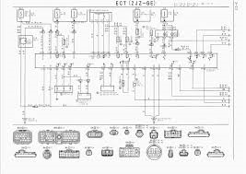



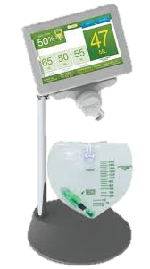
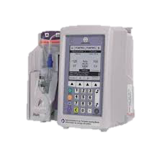
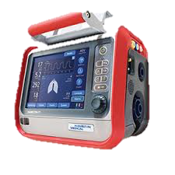


Updated: 2021-05-04
MDIRA Role in System Development
Reference Architecture Specification
Requirements & Guidance for:
Interoperability
Security
Modularity
Functionality
Implementation
Etc.
MDIRA-enabled Heterogeneous Decoupled Ecosystem of Plug-and-Trust SES MDI Products!
MDIRA
Specifications
ISO/IEEE 11073 SDC Standards
IHE SDPi Profiles
IHE MDIRA Profile
…
System Requirements
& Architecture
Operational
Requirements
& Concept
MDIRA Reference Implementations
IHE MDIRA / SDPi Implementations
…
Design
Specifications
System
Implementation
Industry Standards and Guidance
An Autonomous
Medical
Care System

Slide 2
MDIRA Role in System Development
Requirements & Guidance for:
Interoperability
Security
Modularity
Functionality
Implementation
Etc.
MDIRA
Specifications
System Requirements
& Architecture
Operational
Requirements
& Concept
Design
Specifications
System
Implementation
Industry Standards and Guidance
An Autonomous
Medical
Care System

